Slide 1



AEMR Outages
Agenda:
Overview of outage types
Outage frequencies
Impacts of each outage type
Breakdown of efficiency of power providers
Go forward plan

Slide 2
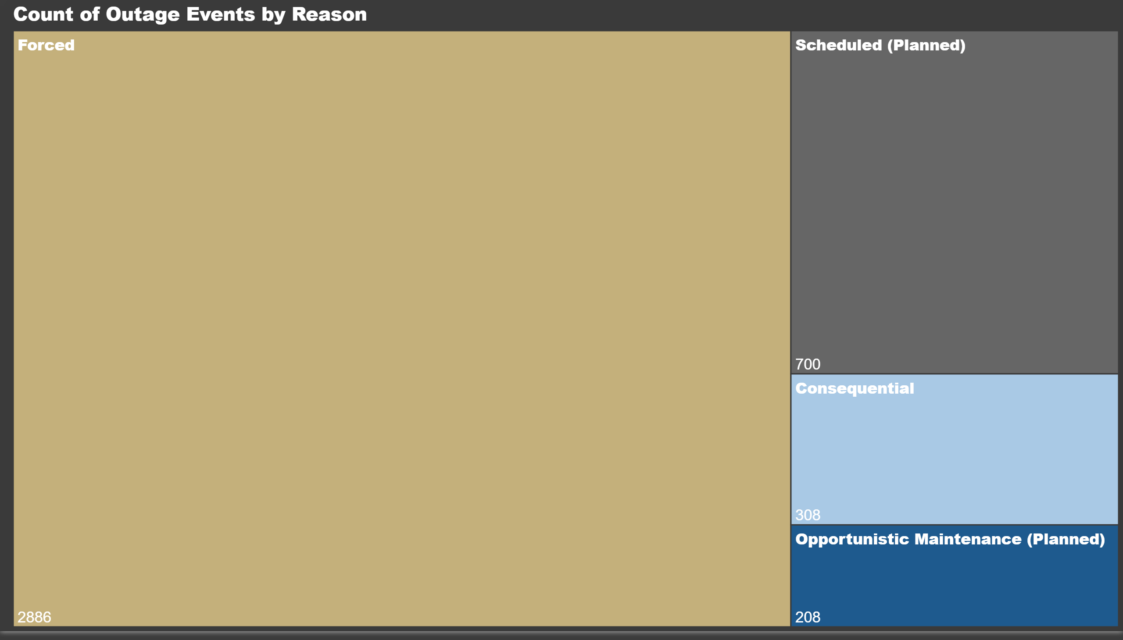

Outage types
4 Types of outages
Forced
Consequential
Scheduled (Planned)
Opportunistic Maintenance (Planned)
Forced makes up a majority & providers are penalized

Slide 3
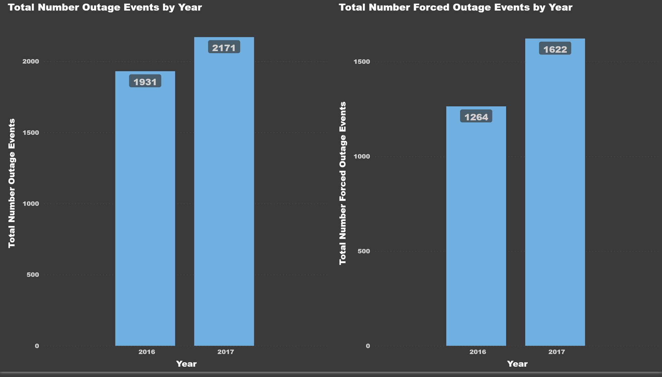
Impact of forced outages
Outages are increasing
Large rise in forced outages

Slide 4
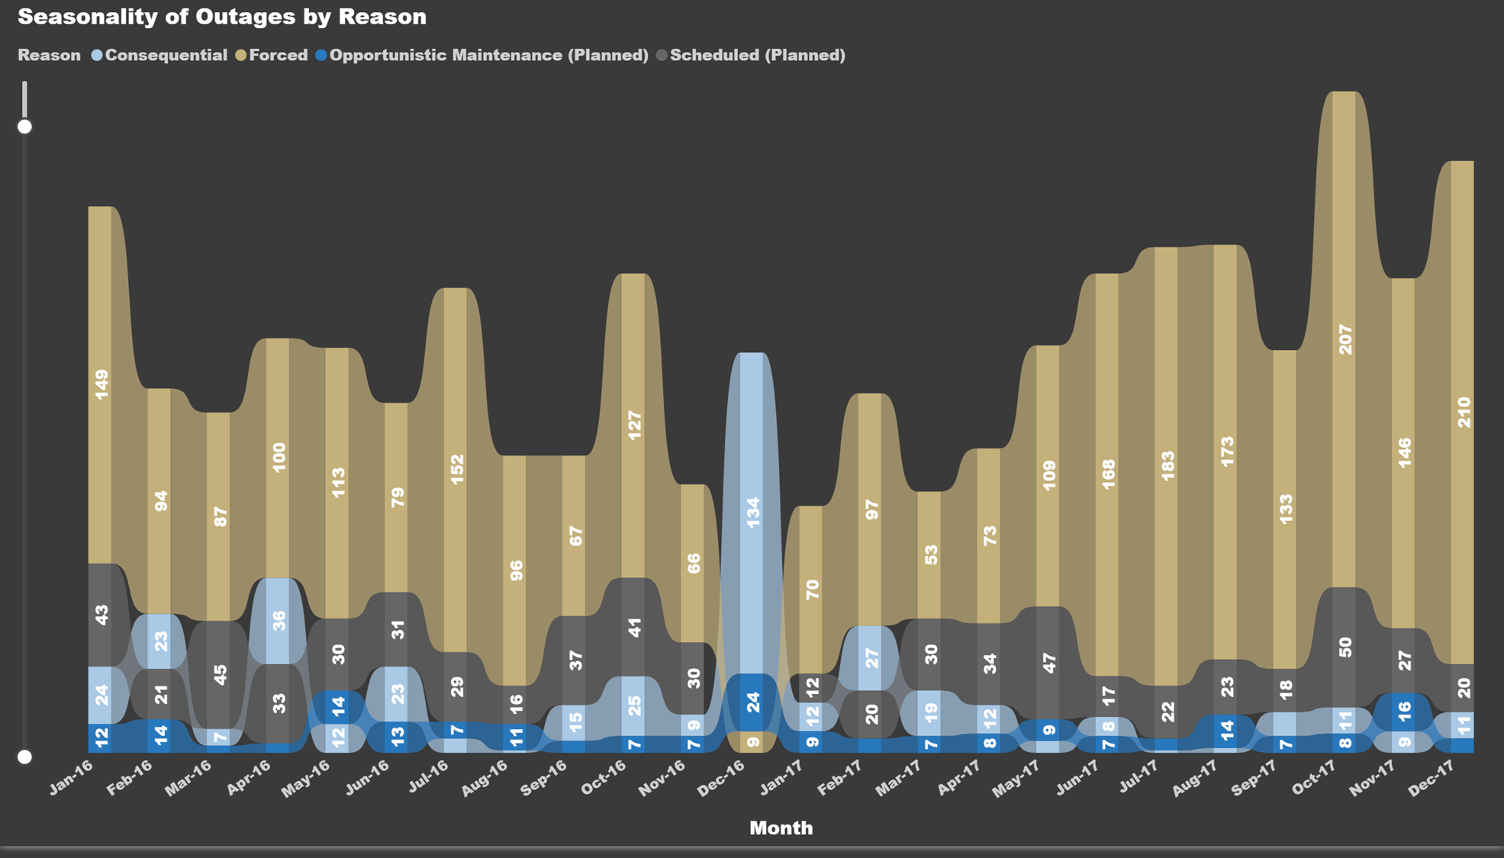
Outage types over time
Forced outages up from 2016 to 2017
Seasonality seen with non-planned outages
Non-Planned outages are highly variable

Slide 5
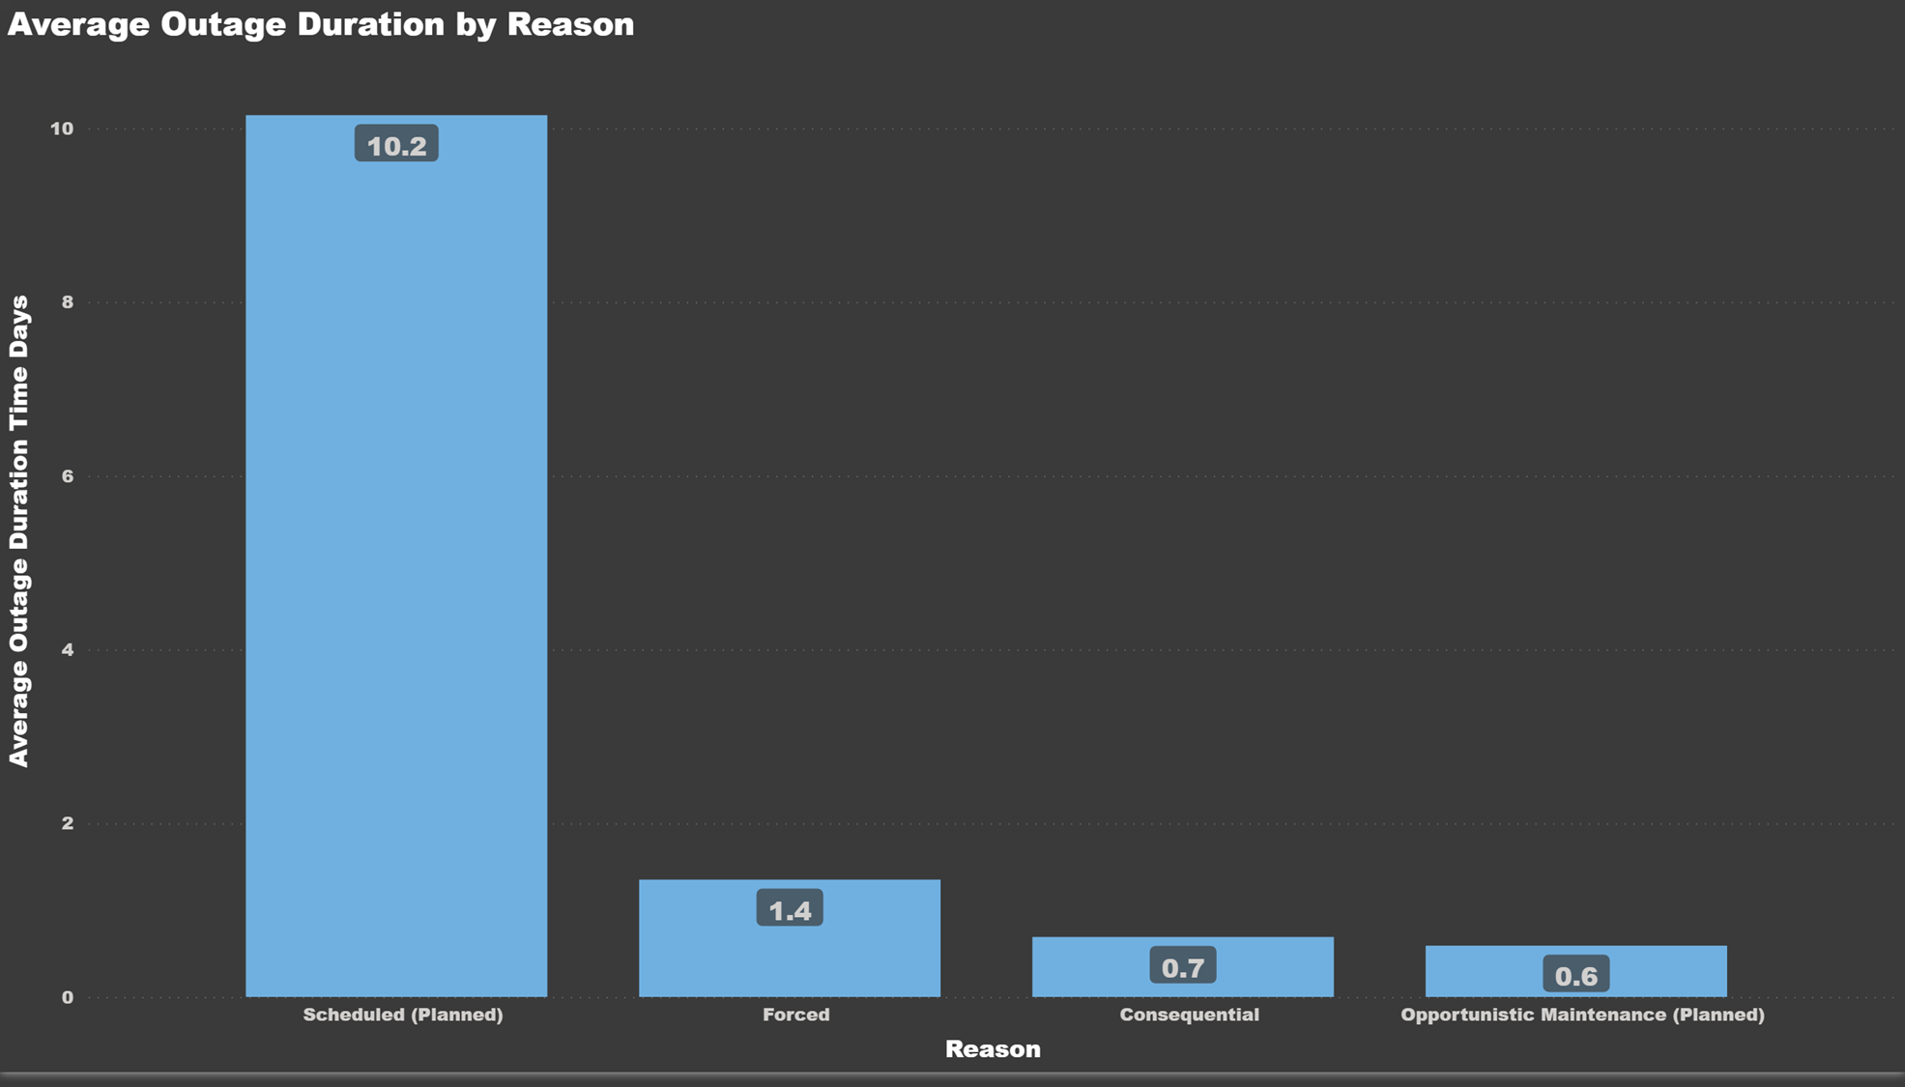
How long are we out?
Planned outages occur for days at a time
Attempt to return power as soon as possible for other three
Crucial for AEMR to compensate for productivity loss

Slide 6
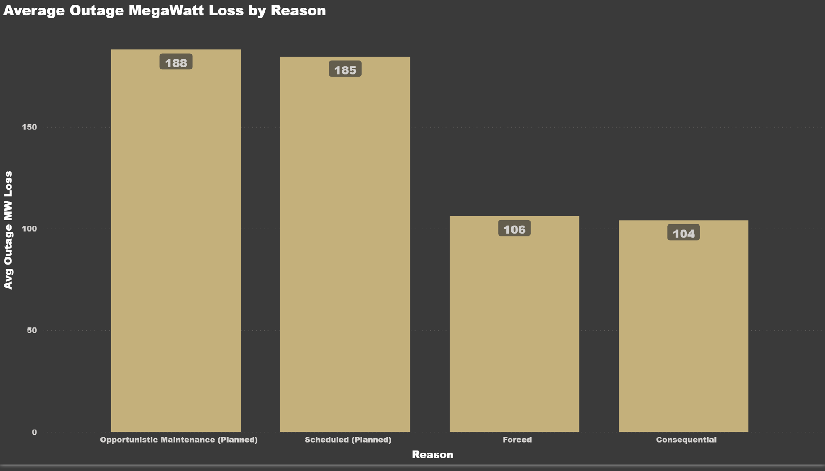
How much power is lost?
1 megawatt powers 813 average US homes for 1 hour
Planned outages tend to result in greater losses in power production
Longer outage ≠ more power lost

Slide 7
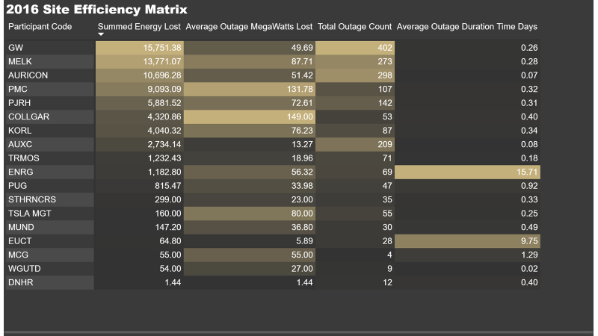
Who is losing the most power 2016?
Correlation between total outage count & summed energy lost
Average time & severity of outage does not impact total energy lost significantly
Locations causing greatest concern:
GW
MELK
AURICON
PMC
PJRH

Slide 8
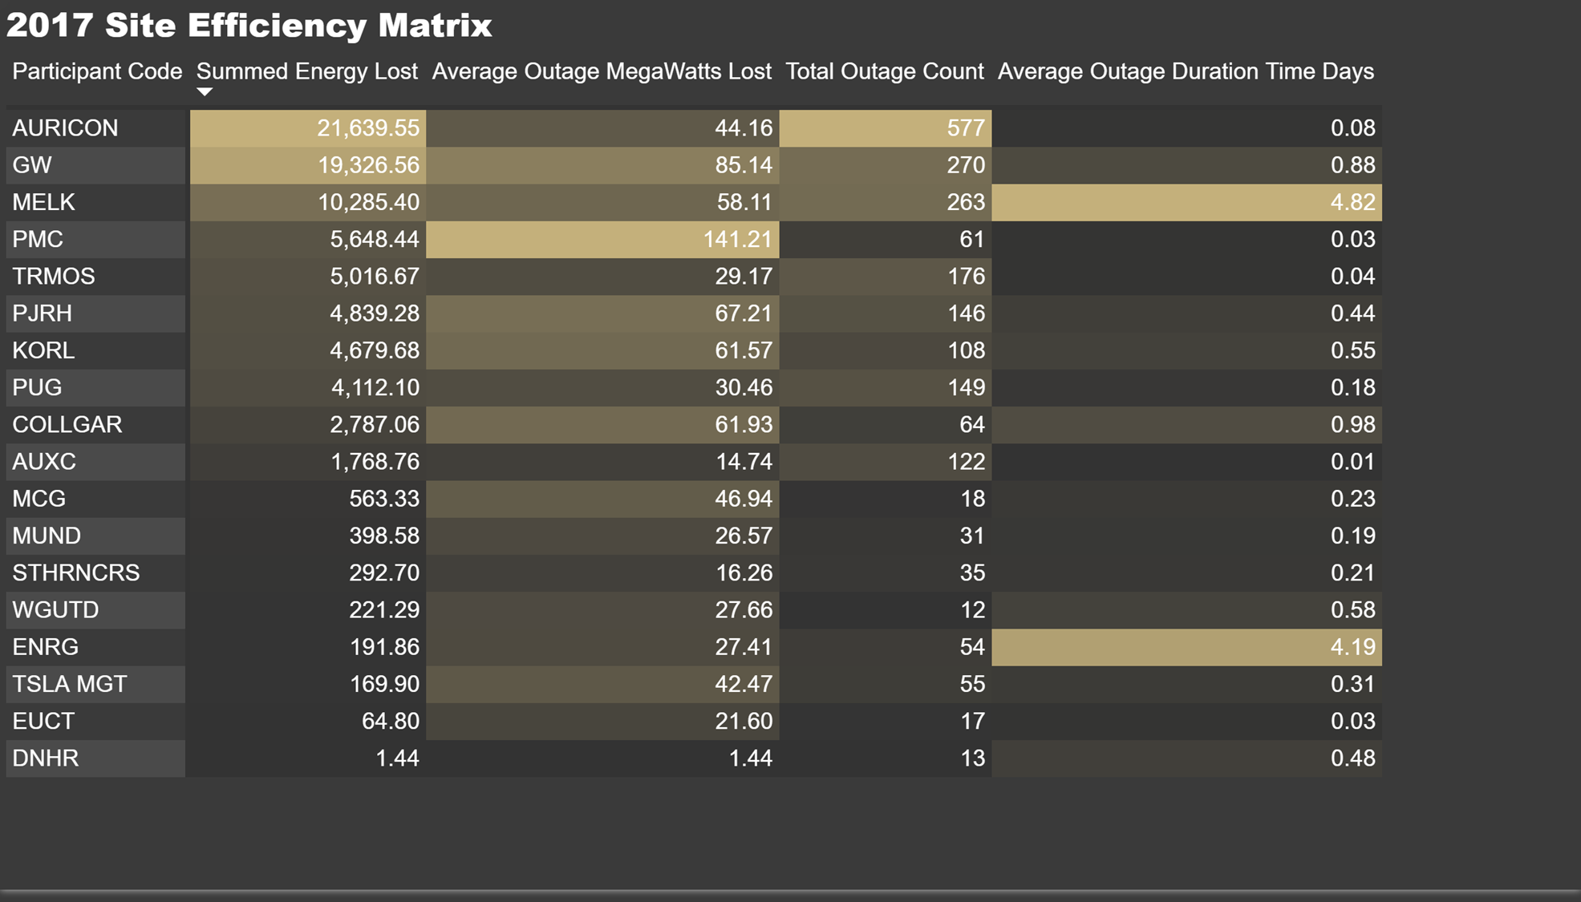
Who is losing the most power 2017?
Correlation between total outage count & summed energy lost
Average time & severity of outage does not impact total energy lost significantly
Locations causing greatest concern:
GW
MELK
AURICON
PMC
PJRH

Slide 9
Recommendations
Analyze lowest performers (AURICON, GW, MELK)
Analyze highest performers (DNHR, MCG, EUCT)
Inspect & penalize
More planned outages

